Slide 1
Covid bed slot booking system
Dbms mini project
Amogh s Bharadwaj (1dt19cs013)
H vishwajit (1dt19cs051)

Slide 2
Abstract
Introduction
COVID BED SLOT BOOKING SYSTEM effectively manages to solve the real-world problem of booking bed in hospital. It integrates database and simpler UI to effectively manage and store the data of Hospitals and Patients.
It stores the Hospital data consisting of details related to hospital and number of beds available. This will be displayed to patients while booking a slot of bed and they can select the bed in hospital and thus data will be updated using triggers.
From this Admin, Government can effectively keep track number of beds available, number of patients admitted and their details such as SPO2 levels and derive a solution to control the spread of corona effectively

Slide 3
About
Introduction
Purpose - This is an attempt to stop people from jumping queue and bringing transparency to bed allocating beds.
Scope -The project provides a very simple application which simplifies the manual work done by the operation team of Covid bed BookingSystem. This application saves the data of hospital bed in the database. Allows users to book bed.

Slide 4
Design

Slide 5
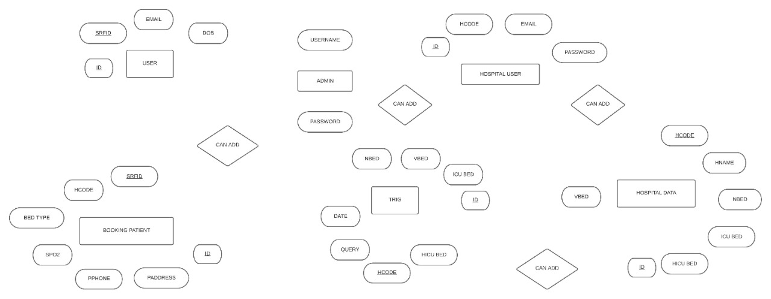
Er diagram -
1
N
M
M
1
N
N
N
M

Slide 6
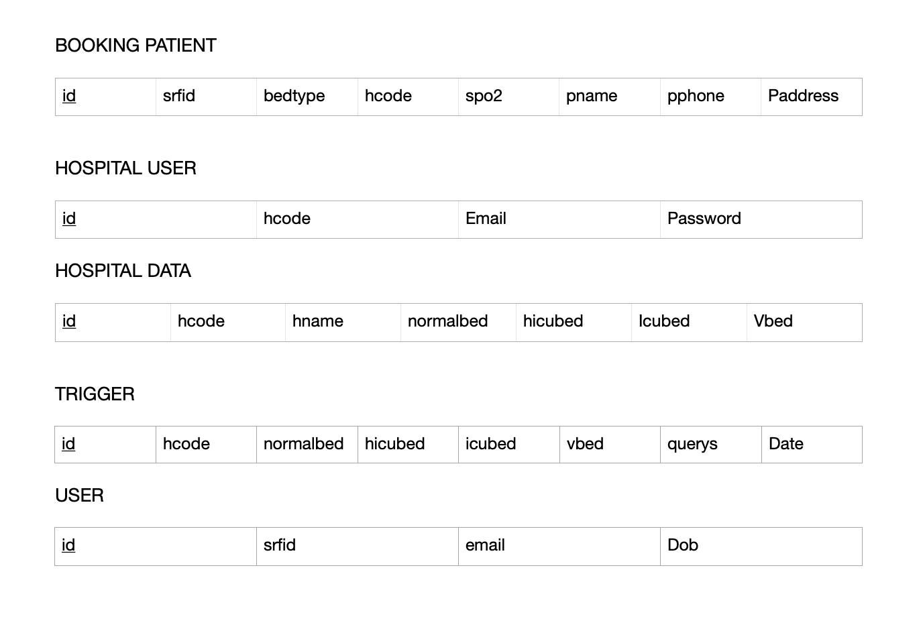
Schema diagram

Slide 7
Implementation

Slide 8
Algorithm -
Implementation
Step 1: Login with admin credentials.
Step 2: Add a Hospital and their credentials.
Step 3: Login with Hospital Credentials.
Step 4: Add Hospital data such as no of beds, hospital name and hospital address
Step 5: Create a login credentials for new user using srfid.
Step 6: login with created credentials.
Step 7: enter the bio data.
Step 8: Select a bed from given list of Hospital.

Slide 9


Front - end development
Implementation
HTML (Hyper Text Markup Language) —
CSS(Cascading Style Sheets) —
Java Script —

Slide 10



Back-end development
Implementation
Python Flask —
Apache
MySQL

Slide 11
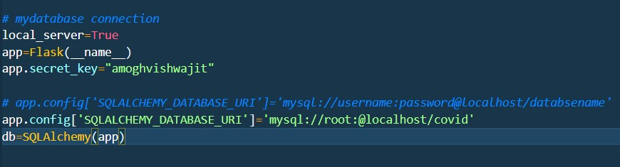
Data base connectivity
connectivity

Slide 12
Snapshot

Slide 13
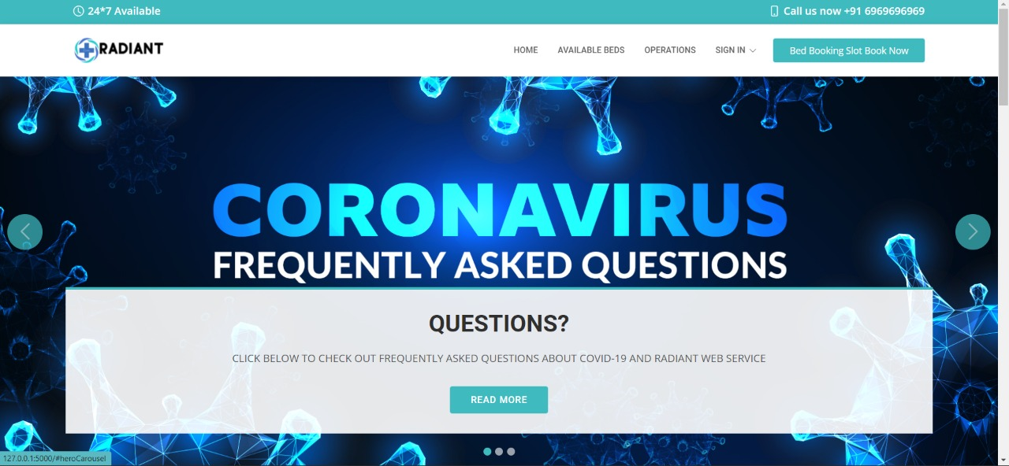
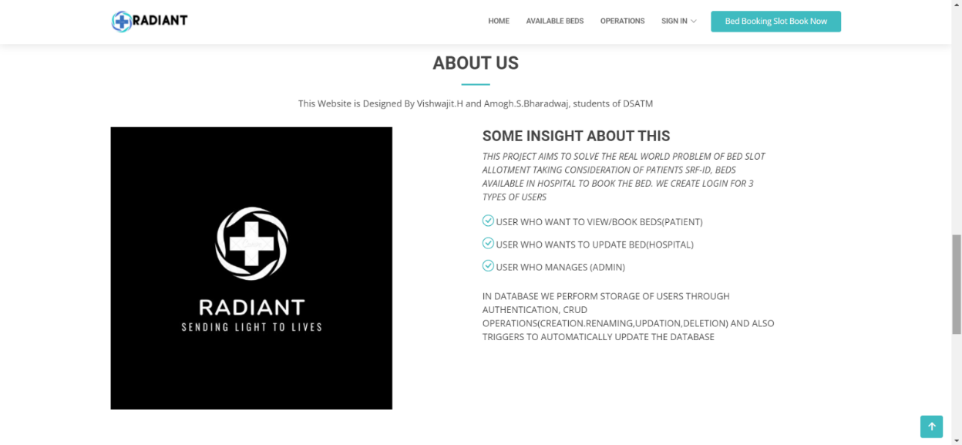
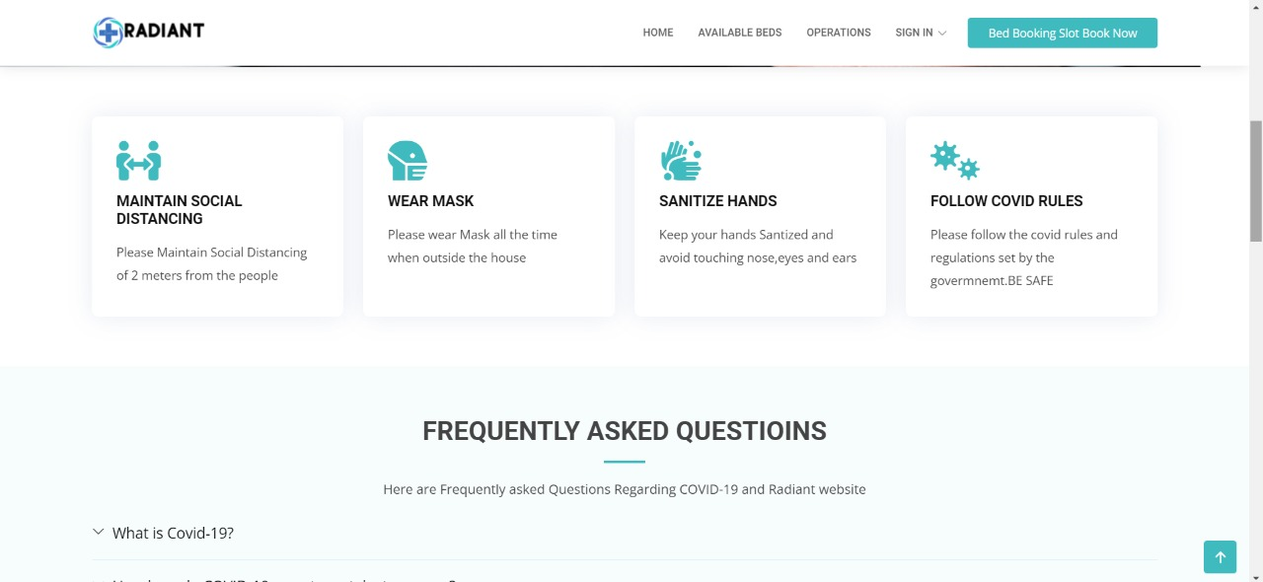
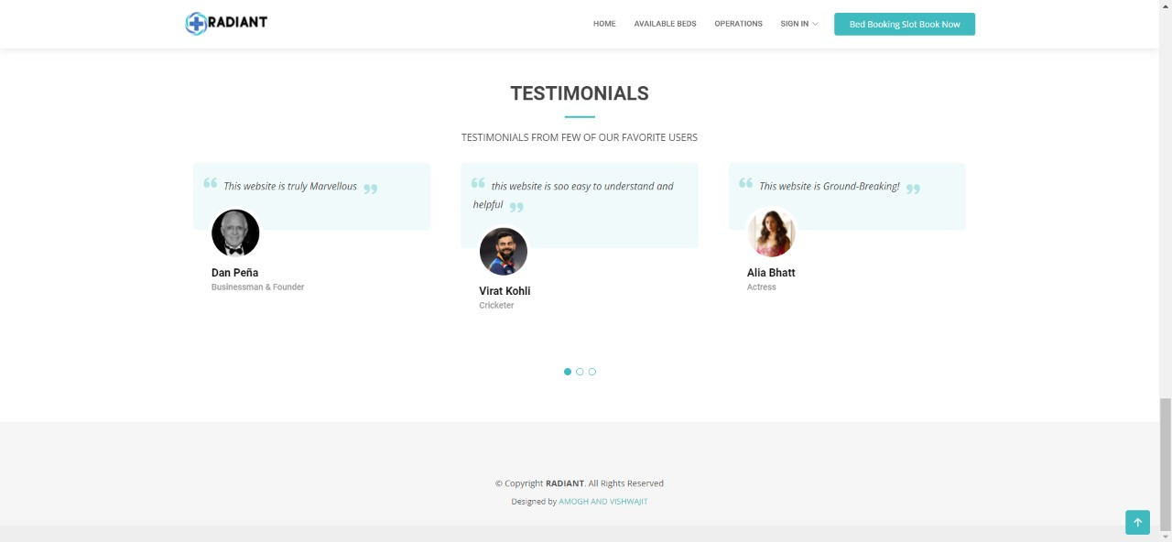
Home
Snapshot

Slide 14
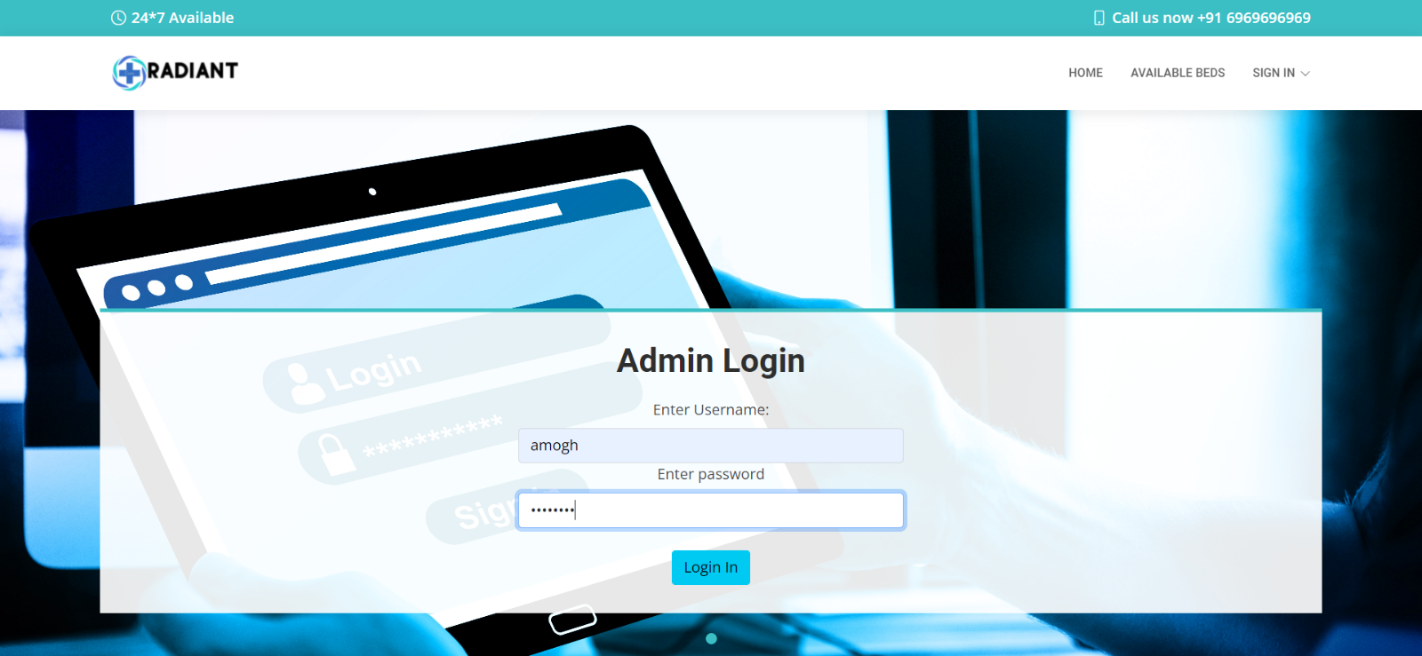
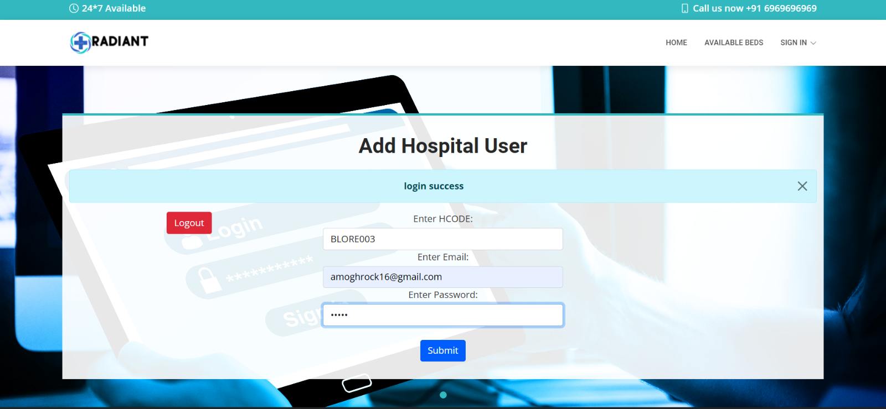
Admin
Snapshot

Slide 15
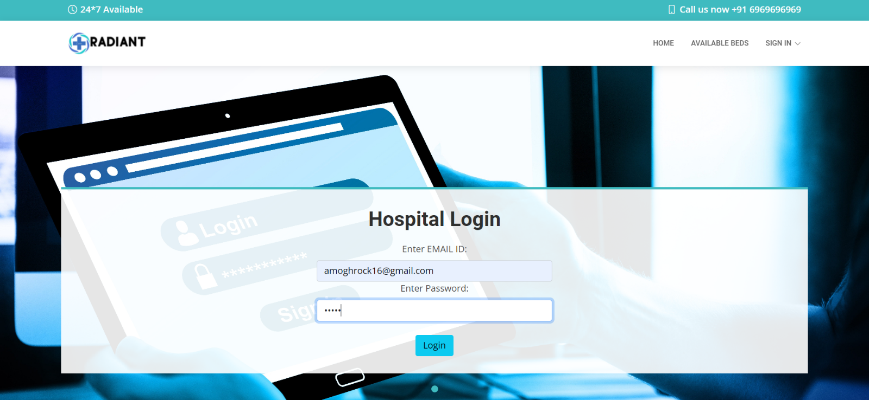
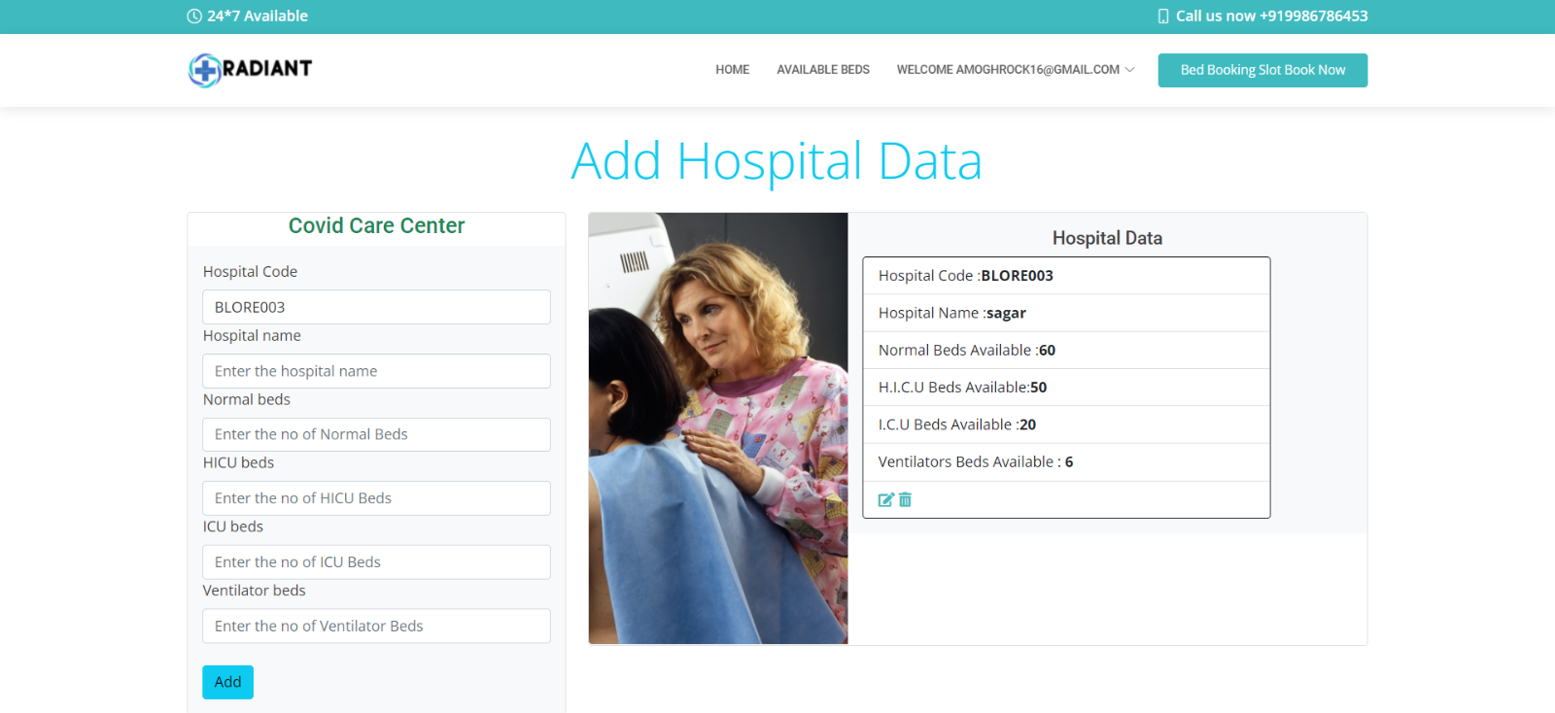
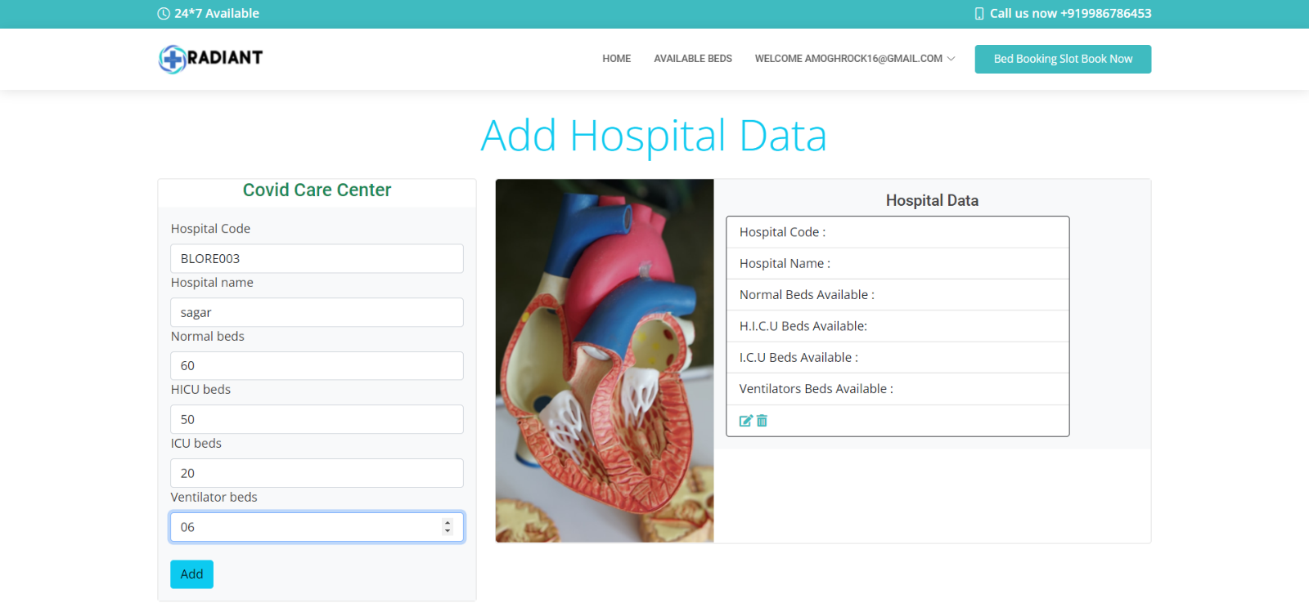
Hospital
Snapshot

Slide 16
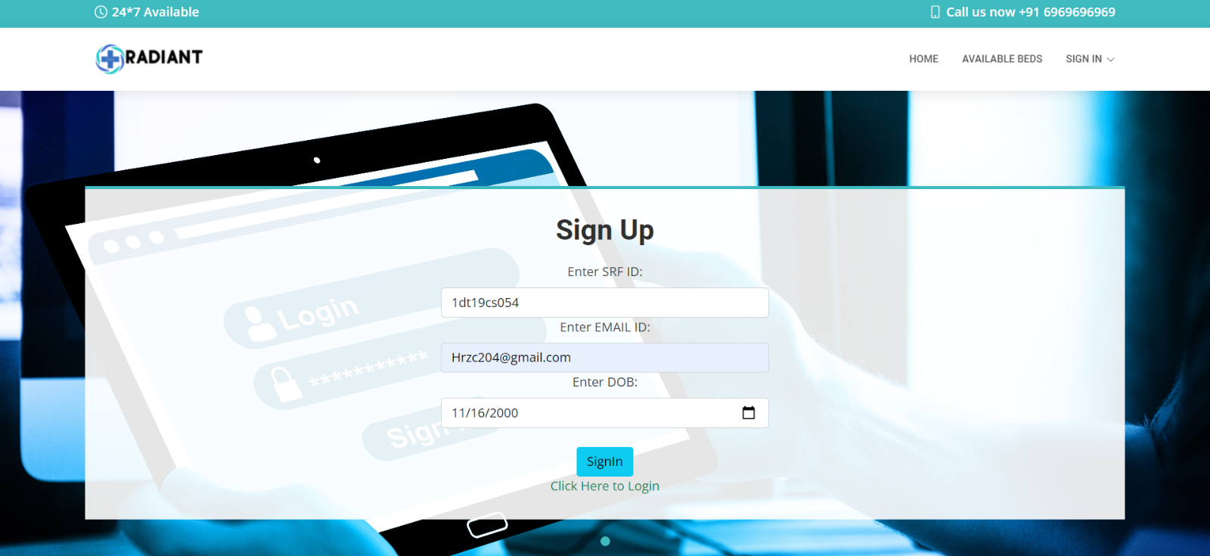
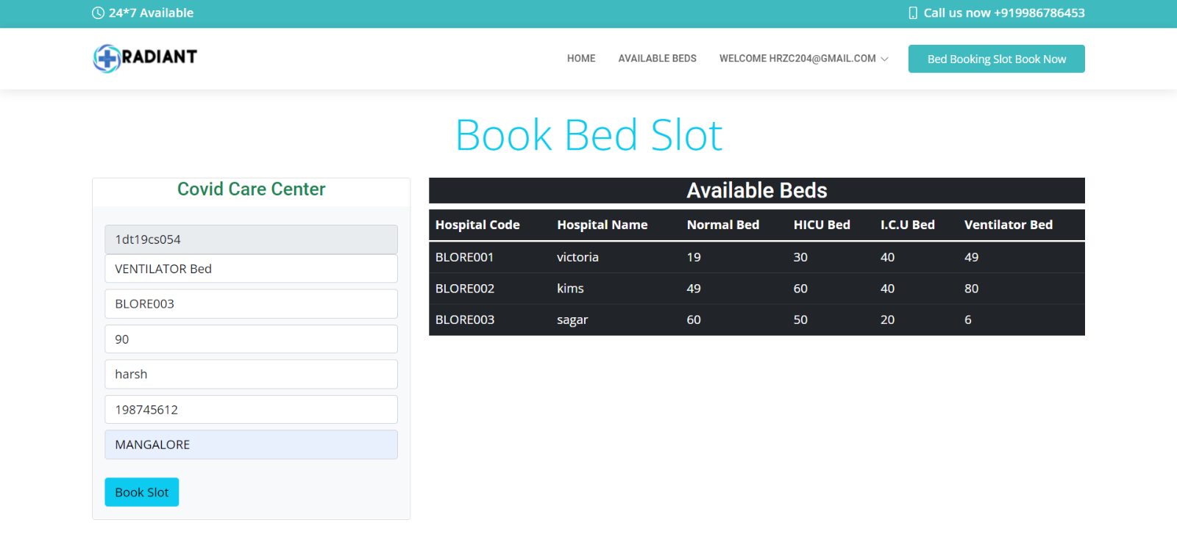
Patient
Snapshot

Slide 17
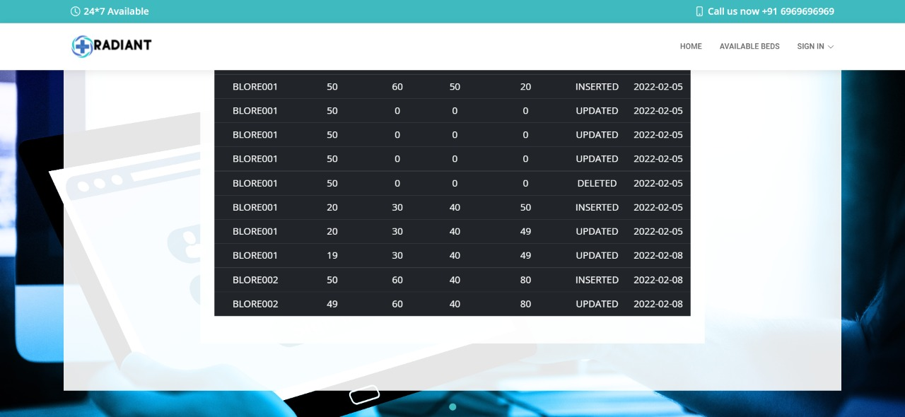
Trigger
Snapshot

Slide 18
Conclusion

Slide 19
Conclusion and merits
The Covid Bed Slot Booking is a great improvement over the manual system which uses lots of manual work. The computerisation of the system speeds up the process. This system was thoroughly checked and tested with dummy data and found to be reliable.
Fast
Efficient
Avoids data redundancy & Inconsistency
Reliable

Slide 20


The end
Thank you !!!
Done by
Amogh S Bharadwaj (1DT19CS013)
H Vishwajit (1DT19CS051)

